Slide 1

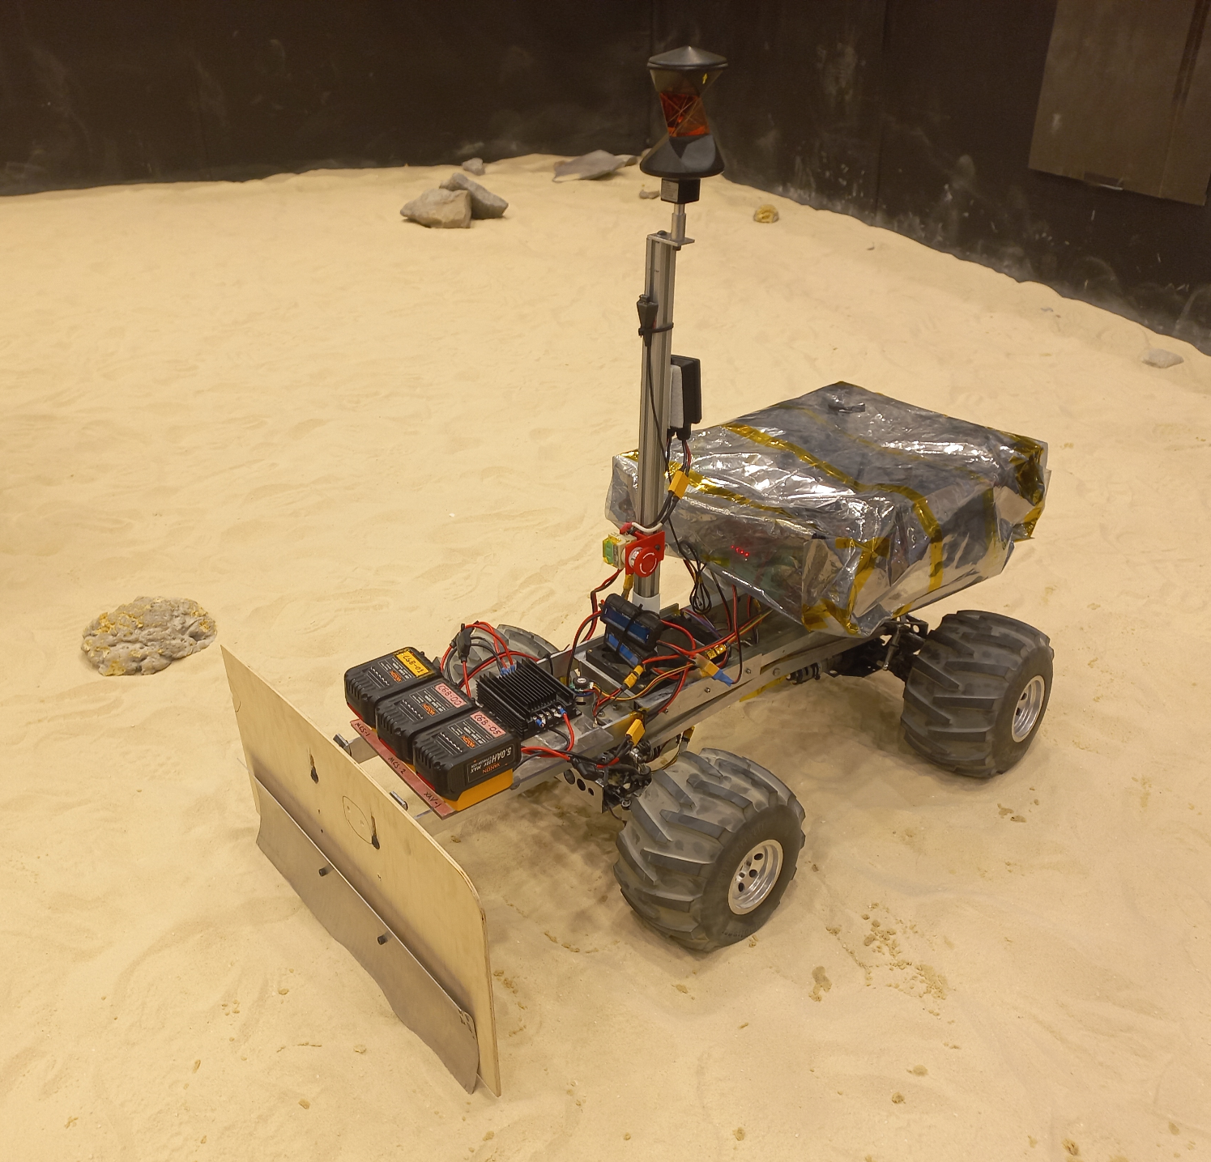

Lunar ROADSTER
(Robotic Operator for Autonomous Development of Surface Trails and Exploration Routes)
“Starting with a foothold on the Moon, we pave the way to the cosmos”

Slide 2
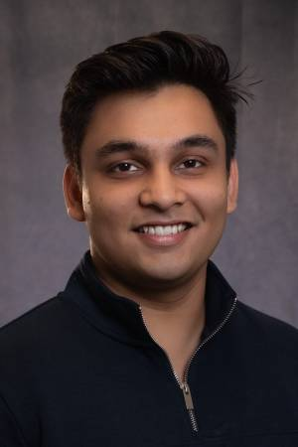
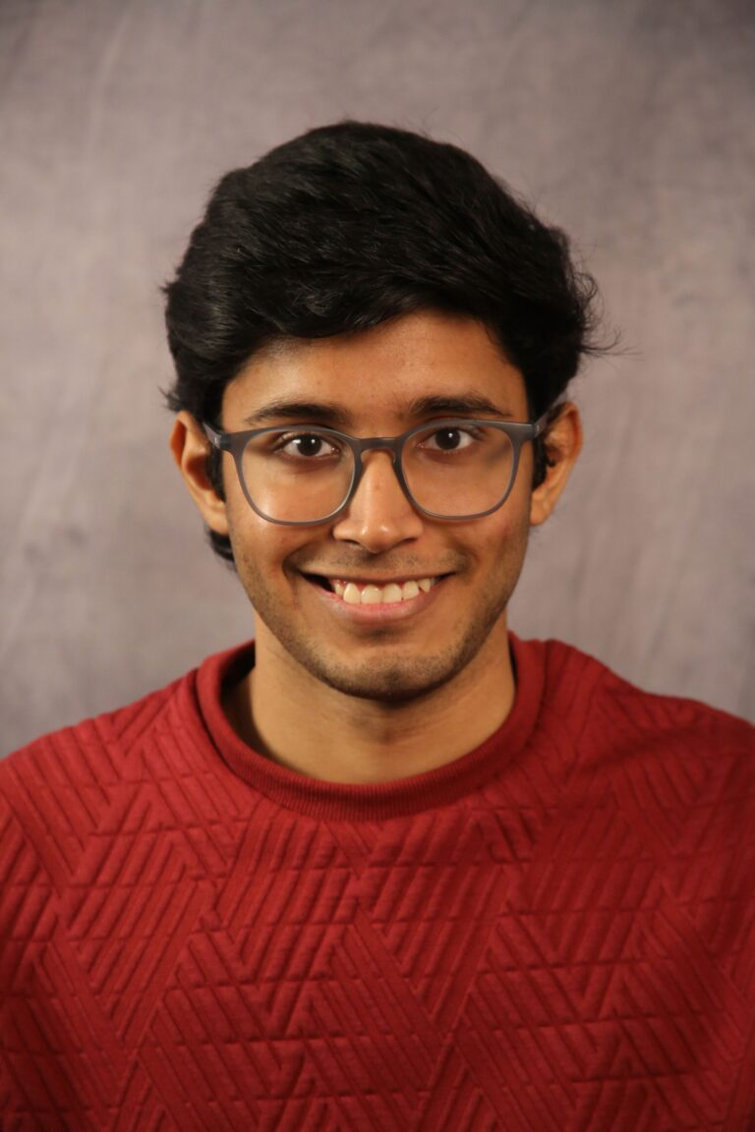
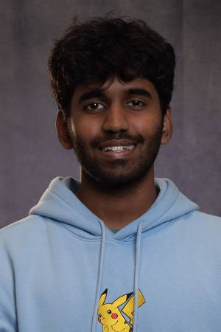
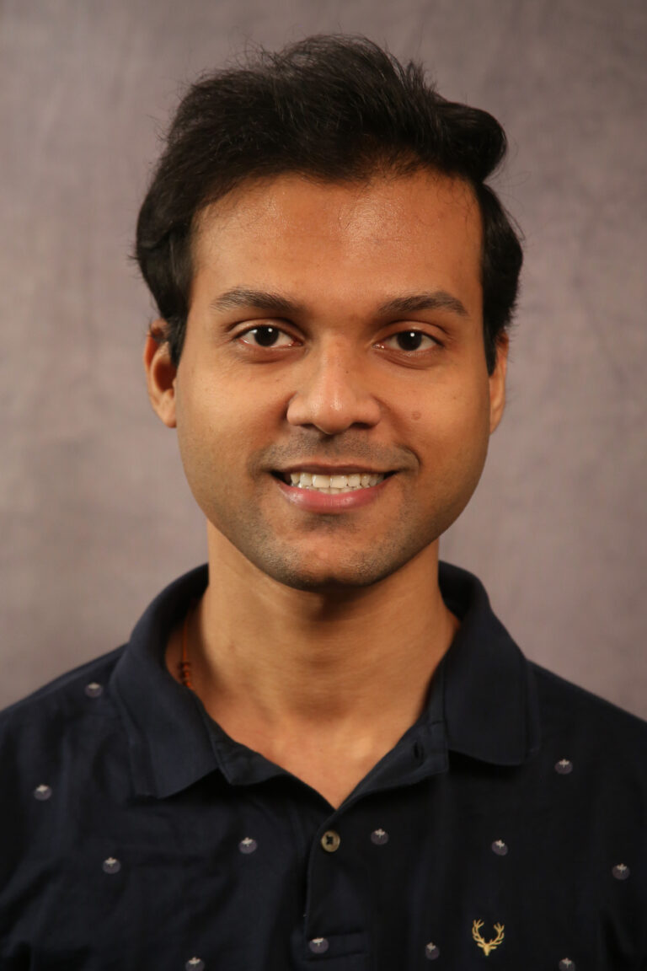
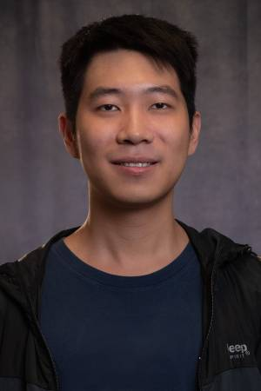
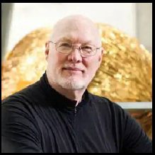
The Team
Ankit Aggarwal
Deepam Ameria
Bhaswanth Ayapilla
Simson D’Souza
Boxiang (William) Fu
Dr. William “Red” Whittaker
Notes:
-Introduce team

Slide 3
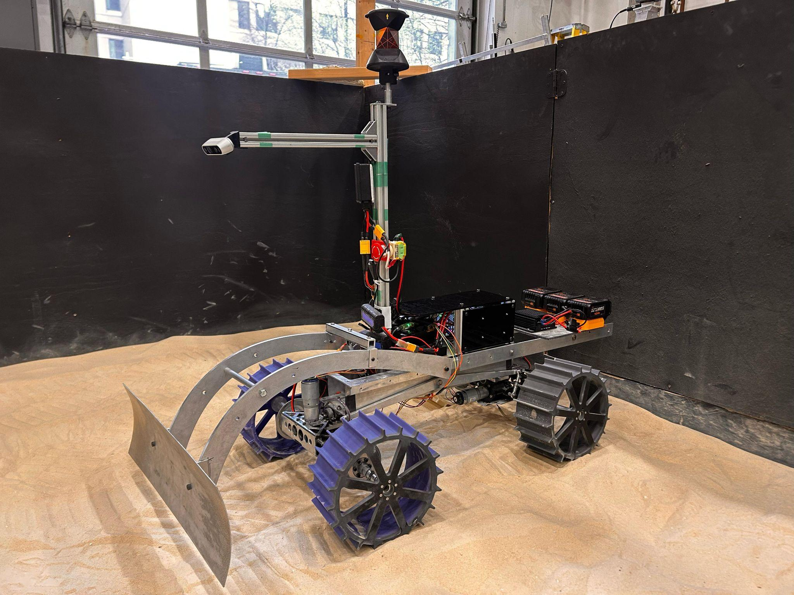

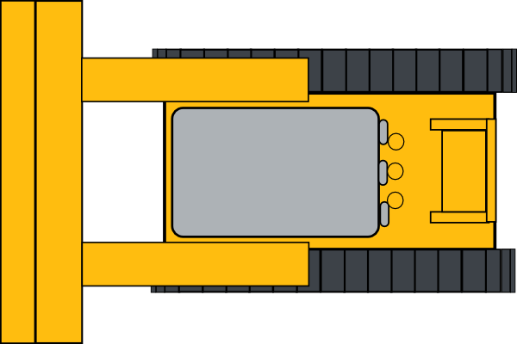
Project Overview: Lunar ROADSTER
Lunar ROADSTER
Reference Latitude
Crater to Avoid
Groomed Path
Original Traversable Path
Craters to Groom
An autonomous moon-working rover capable of finding ideal exploration routes and creating traversable surface trails
3
Notes:
By grooming trail paths, rovers with less traversing capabilities will be able to travel at higher speeds and higher power efficiencies.
A traversable and circuitous trail path will allow rovers to maintain sun-synchronicity, thereby allowing machines to run for much longer.
The groomed trails will become the backbone for colonization of the Moon by enabling transportation, logistics and enterprise development.
The dotted line represents a chosen latitude, the blue path represents the original, rough, circuitous path
The green lines represent the groomed path that makes the original path much safer, direct and energy-efficient for solar powered rovers.
The rover will create this path while grooming certain craters in its path, while avoiding big/deep craters

Slide 4
Technical: Subsystem Status
Subsystem | Completion % | Future Work
Sensors | 75% | Integrate New IMU and Fisheye Camera
Computations | 60%
1. Jetson and Docker | 90% | Set Up New Sensor Drivers
2. Localization Unit | 80% | Implement Skycam Localization
3. Transport Planner Unit | 60% | Implement New Transport and Tool Planner
4. Navigation Planner Unit | 40% | Generate Map and Implement Global and Local Navigation Planner
5. FSM Planner Unit | 70% | Update FSM to Support New Modules
6. Validation Unit | 10% | Detect Craters and Implement Validation module
External Infrastructure | 90% | Implement New Total Station Localization Method
Mechanical | 90% | Fabricate and Install Actuator Arch
Actuation | 85% | Linear Actuator Upgrade/Tuning
Electrical Power | 100% | None
4

Slide 5
Technical: Key Challenges and Associated Plans
Subsystem | Challenges | Plan
Computations
1. Localization Unit | External localization, while highly accurate, introduces latency that degrades navigation performance | Implement Skycam-based localization, if successful, adopt it permanently, otherwise revert to total station localization
2. Navigation Planner Unit | Nav2 package is computationally intensive, its path planning is not well-suited to our robot’s mobility and negatively impacts overall system performance | Develop a custom navigation planner and controller optimized for our use case
3. Validation Unit | Limited progress has been made on the validation module, and implementing the validation pipeline will be difficult | Start development early and break the validation pipeline into smaller, manageable stages to ensure steady progress
External Infrastructure | Current total station method requires a full re-setup whenever the device is turned off or its batteries are replaced | Implement a new total station–based localization method to eliminate the need for repeated setups
Actuation | Tool (Blade) linear actuator frequently jitters during motion | Tune the PID controller or replace it with a higher-quality linear actuator

Slide 6

Project Management Methodology
High-level V-model with clearly defined project scope and work units to complete
Low-level Agile method with 2-week sprints
Milestones set every sprint to coincide with PRs
Regular standup meetings
Predictive budgeting, scheduling and resource allocation, with adjustments based on real-world testing and feedback
Task allocation based on a combination of skills and interests - optimizing team member motivation and learning objectives
Team-level decision making is decentralized; all members get a say and the team converges to a solution
Amalgamation of Traditional and Agile PM

Slide 7

Project Management Methodology
Standup Meetings Methodology
Standups on MWF
Weekly Meetings with Sponsor - Dr. William ‘Red’ Whittaker
Everyone is and has been showing up :) (Sometimes members attend virtually)
Questions being used:
What have you worked on since the last standup?
What are you going to work on?
Is there any help you need? Does your work affect anyone else’s ongoing work?
Modifications from previous semester:
Switching from daily to every other day (lesser workload)

Slide 8
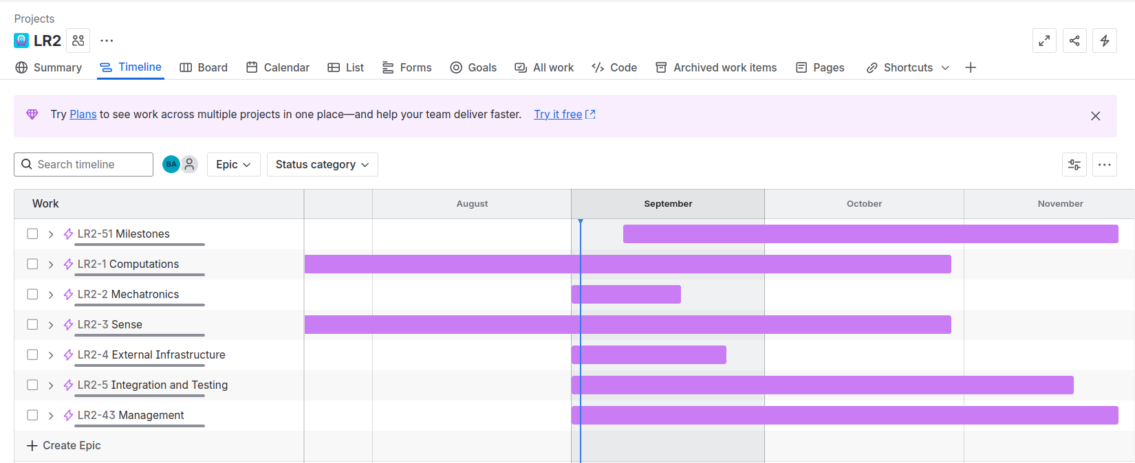
Project Management Tools
Jira - Managing Schedule
Provides clear timeline view
Gantt chart to track progress of each subsystem
Notes:
Interactive and everyone needs to speak

Slide 9
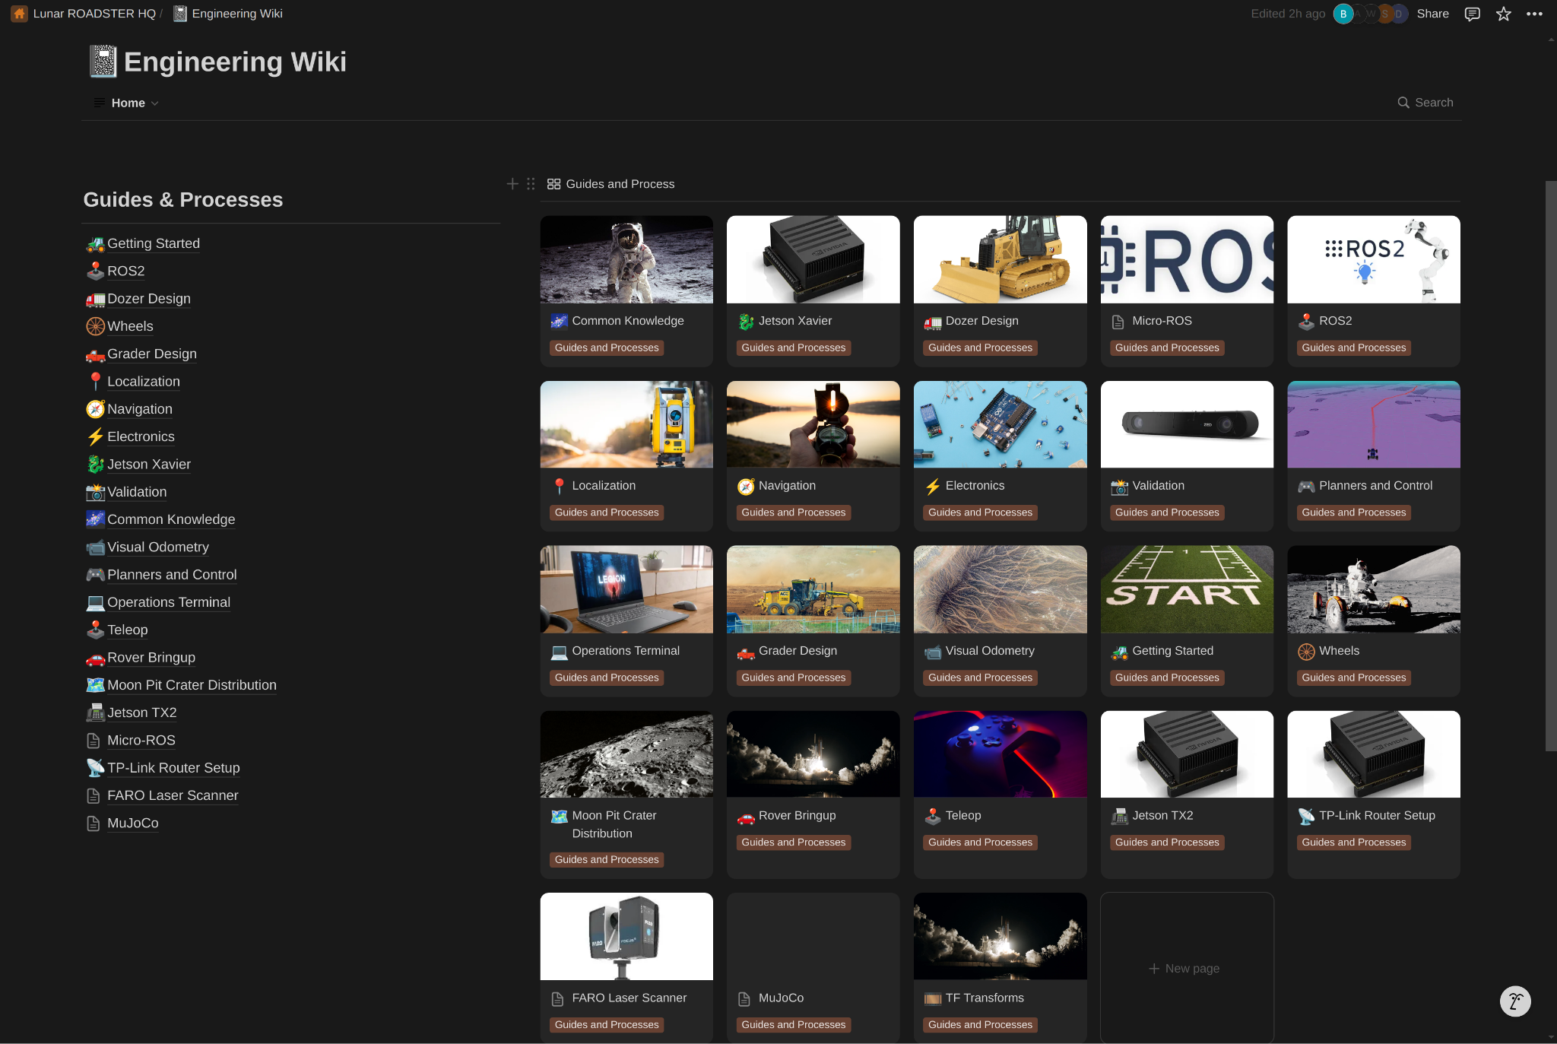
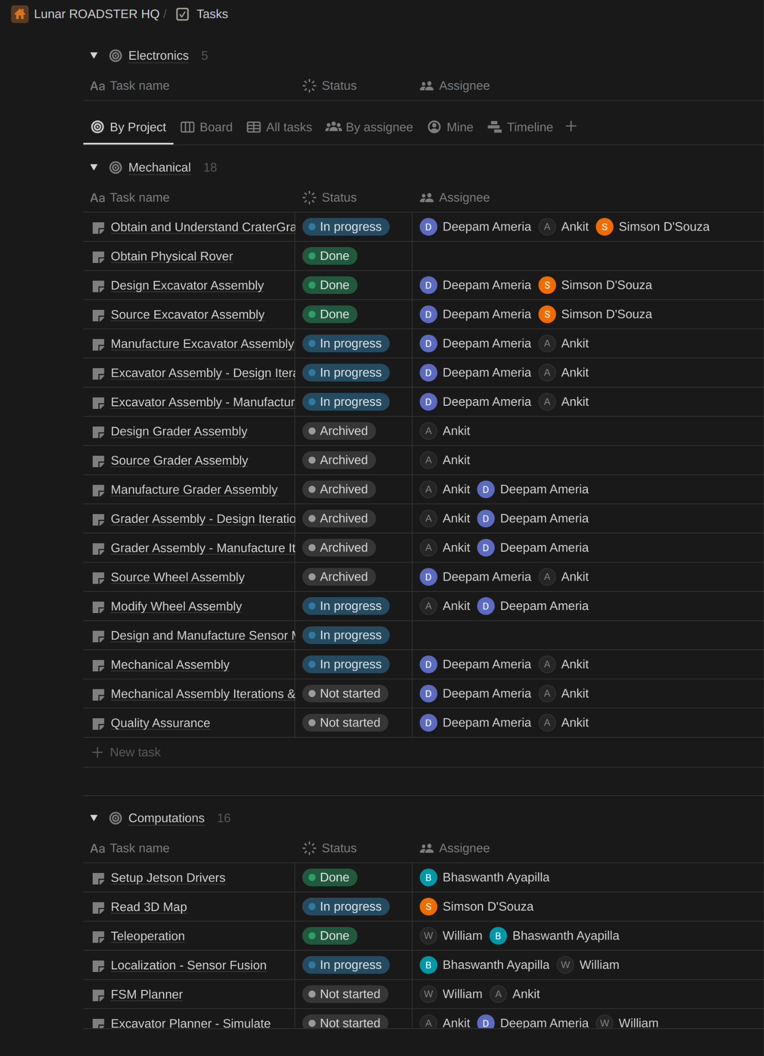
Project Management Tools
Notion - Documentation, Task Assignment & Meeting Notes
Notes:
Interactive and everyone needs to speak

Slide 10
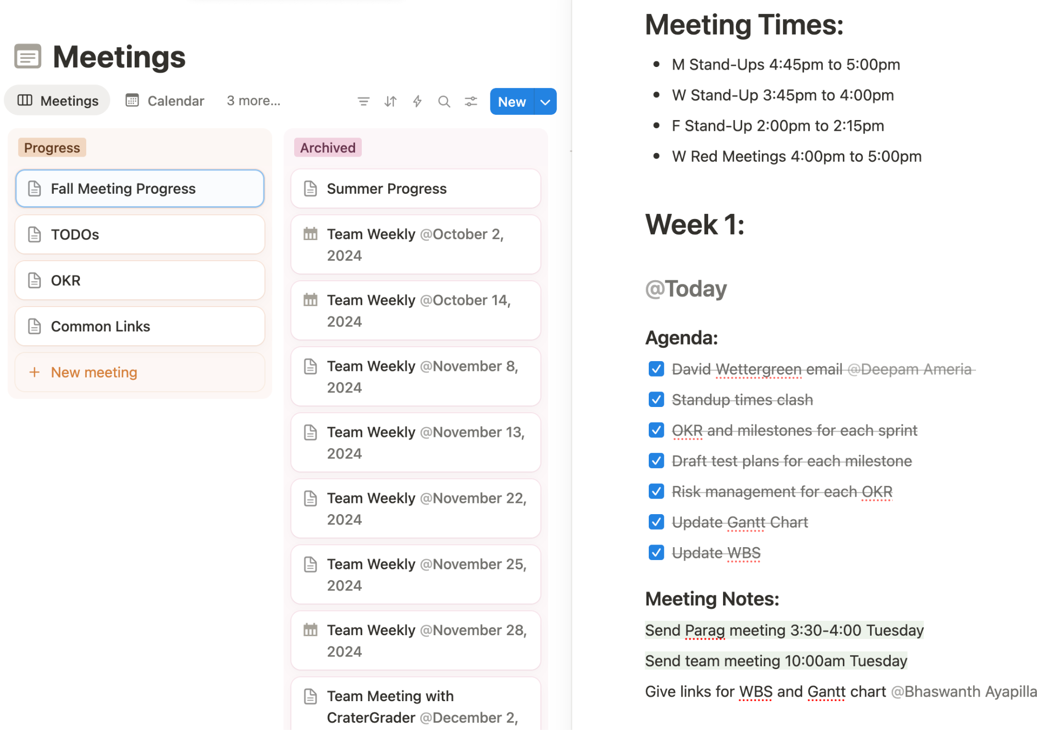
Project Management Tools
Notion - Documentation, Task Assignment & Meeting Notes
Notes:
Interactive and everyone needs to speak

Slide 11

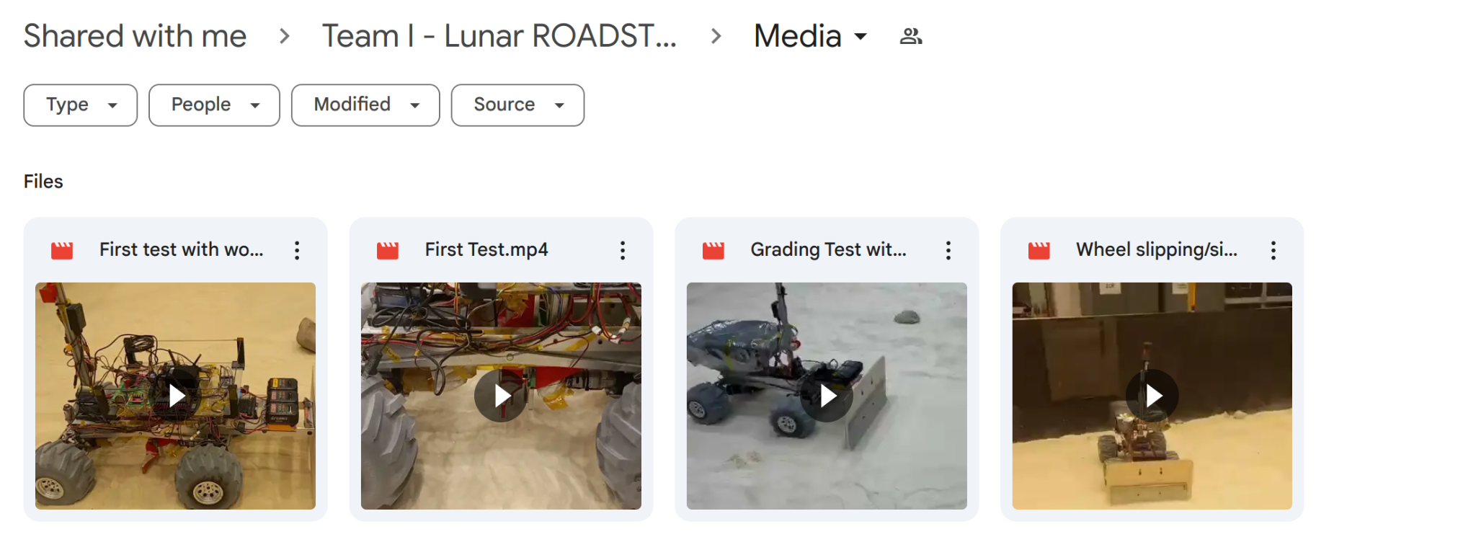

Project Management Tools
Share important resources
Hold virtual meetings
Share test results and other relevant media
Google Drive -
Upload testing videos
Upload project relevant documents
Notes:
Interactive and everyone needs to speak

Slide 12
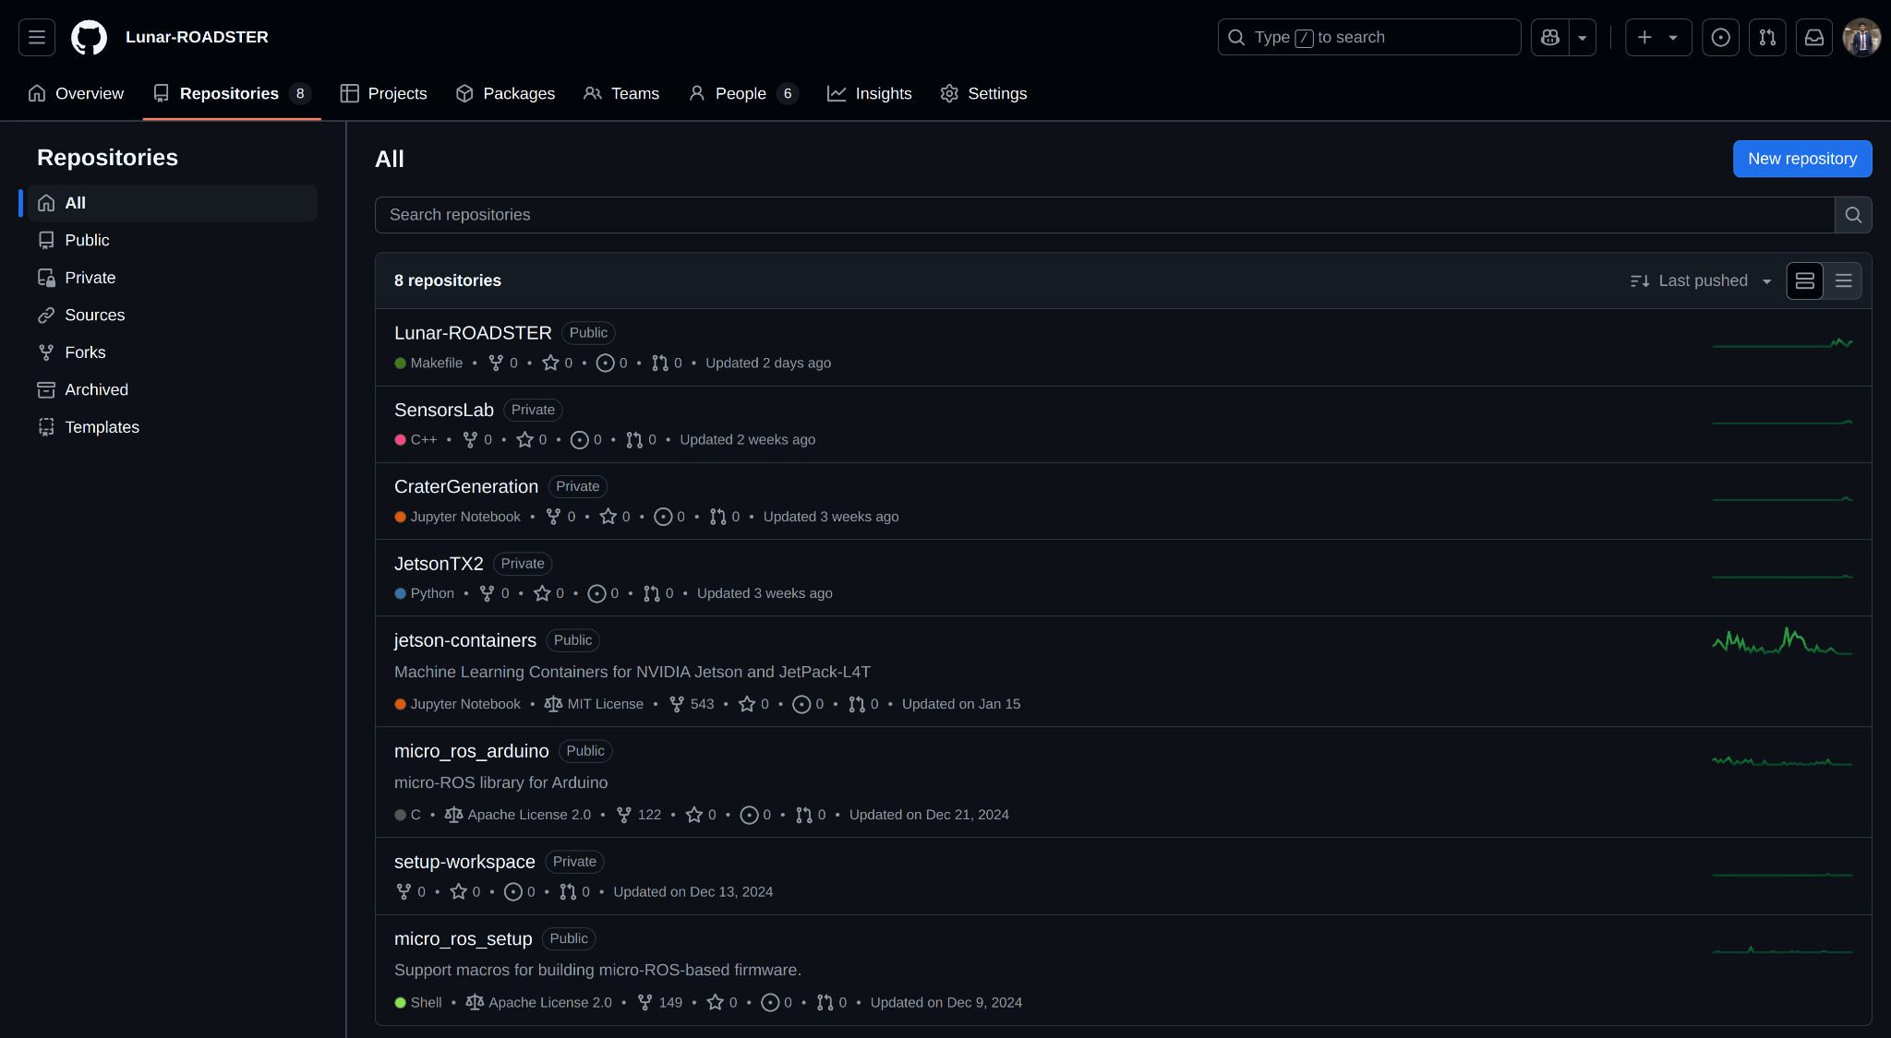
Project Management Tools
GitHub - Managing Code Collaboration
Notes:
Interactive and everyone needs to speak

Slide 13
Lessons & Improvements
S.No | Lesson | Improvements
1 | Deadlines and milestones missed leading to time crunch close to SVD | Introduced Objectives & Key Results (OKR) framework to track progress with development deadline in PR 10
2 | Code sometimes breaks or fails to build due to newly added code | New GitHub version control to track new additions to codebase
3 | Poor code documentation and difficult to read code | Standardized code convention and architecture
4 | Testing schedule often missed as development is prioritized | Testing tracked as a part of OKR; testing schedule bundled with sprint milestones
5 | Hardware needs to be robust, even small issues affect the entire timeline | Consistent testing of software on hardware in the MoonYard
6 | Integration being left to the end causes unprecedented issues and delays | Following a Continuous Integration and Testing methodology

Slide 14
(New!) Objectives & Key Results (OKR)
Definition:
Framework used to define goals (Objectives) and track progress toward them (Key Results)
Requirements
Used mandatory performance requirements defined in Critical Design Review to come up with clearly defined Objectives for FVD (PR 12)
Back-substituted to previous PRs to determine what Key Results needs to be achieved to achieve the Objectives for the next PR
Assigned owners to each Key Result to benchmark contribution
FVD Objectives
PR 11 Key Results
Key Result Owner
…
PR 7 Key Results
Key Result Owner

Slide 15
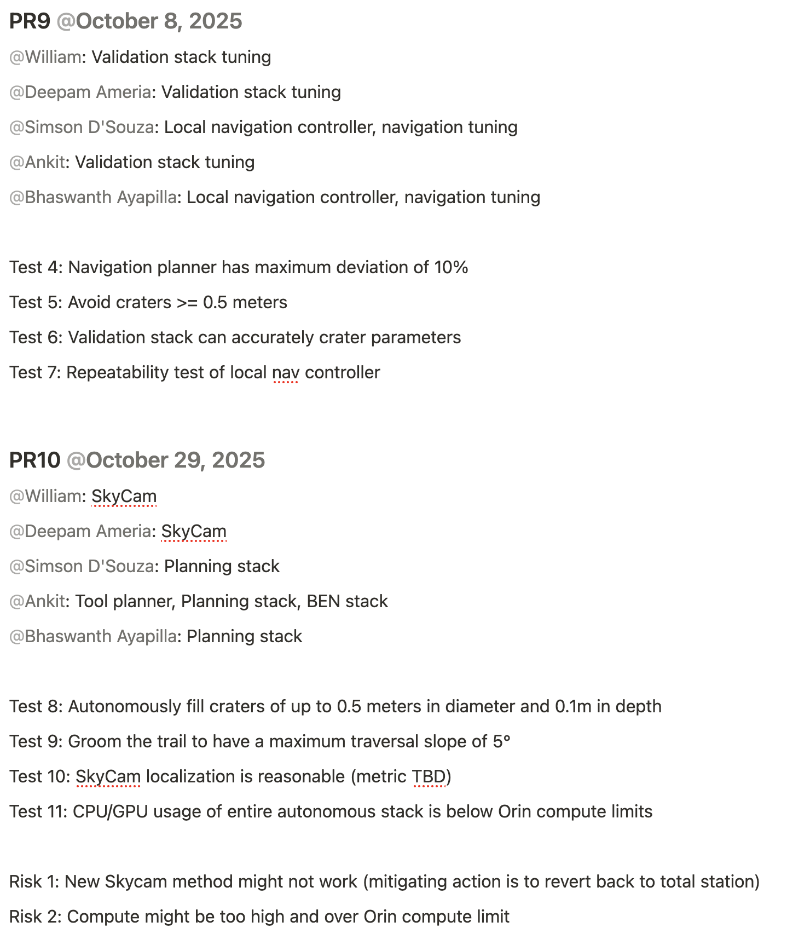
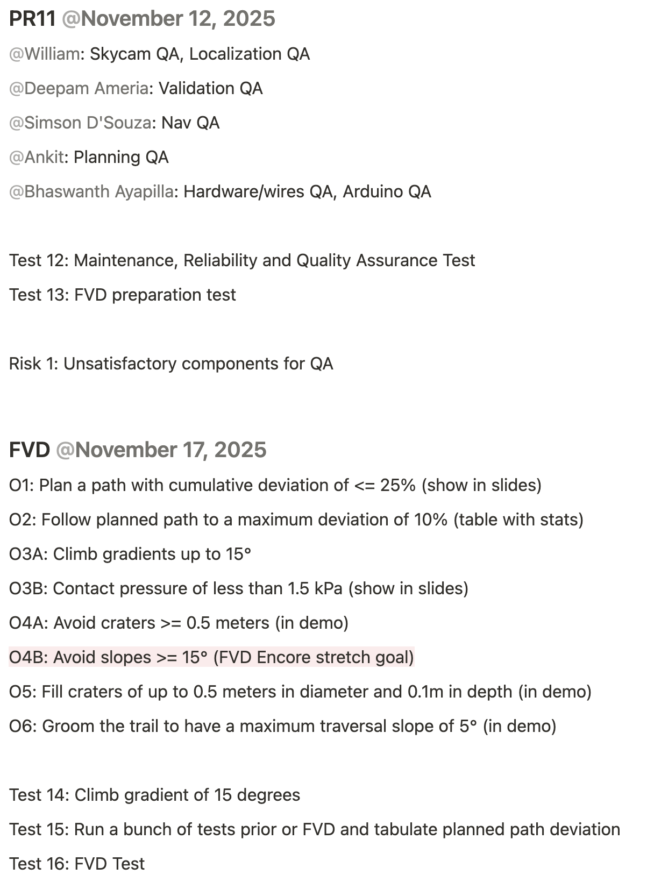
(New!) Objectives & Key Results (OKR)
OKR Identifies:
Risks
Dependencies between work units
Downscoping of requirements
Stretch goals
OKR Guides:
Work Breakdown Structure
Gantt chart
Testing schedule
Risk mitigation plan

Slide 16
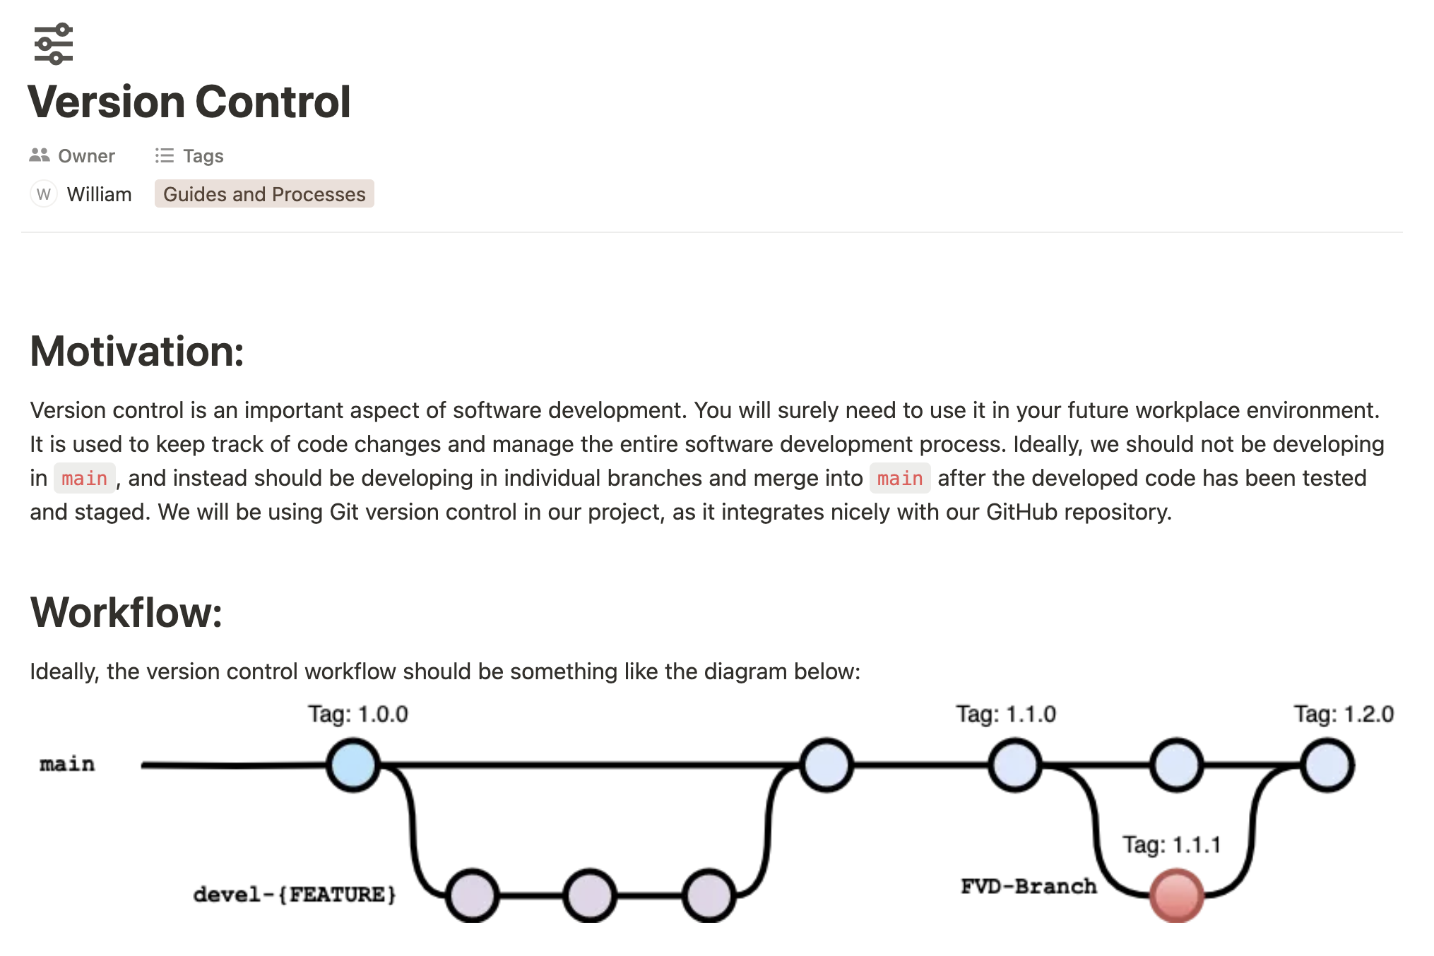
(New!) GitHub Code Version Control
Introduced documentation and coaching on version control and using pull requests and branching in GitHub

Slide 17
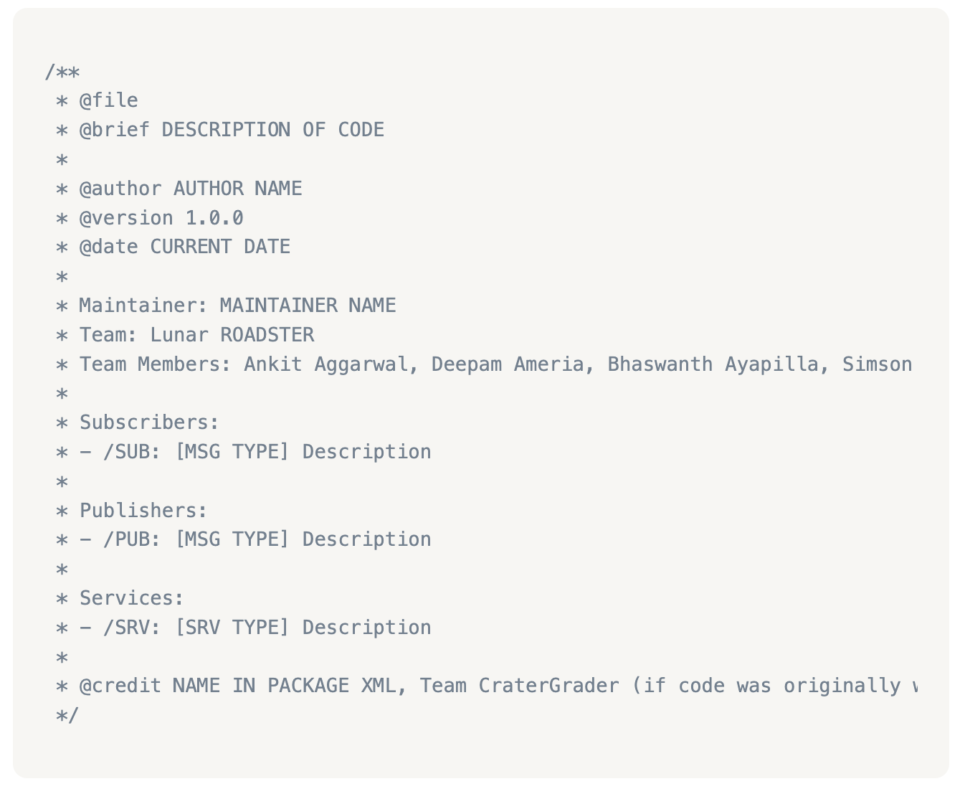
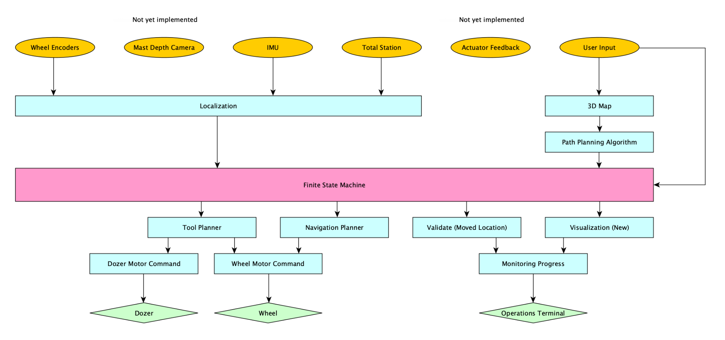
(New!) Code Quality & Architecture
Code Quality:
Standardized code namespace, header information, and package.xml metadata
Code Architecture:
Refactored ROS topics to conform to a Directed Acyclic Graph (DAG) architecture
Definition:
A finite directed graph with no directed cycles. Arrows dictate the flow of information

Slide 18
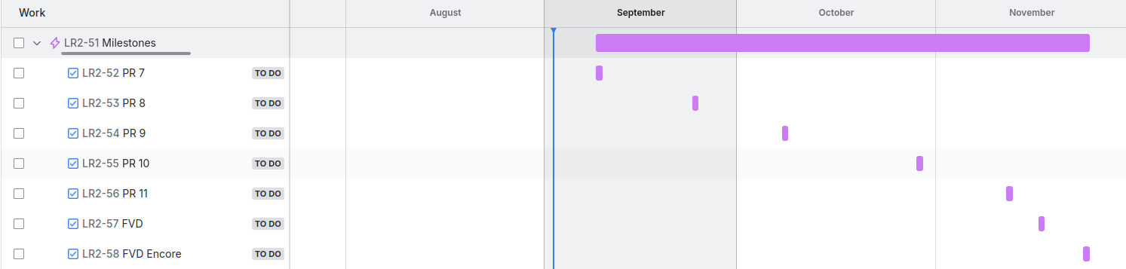
Schedule and Milestones
Milestones | Goals
PR 7 (Sept 10th) | Hardware and software refinement
PR 8 (Sept 24th) | Initial setup of validation stack and navigation planner
PR 9 (Oct 8th) | Tune validation stack and navigation stack
PR 10 (Oct 29th) | SkyCam-based localization for improved global positioning
PR 11 (Nov 12th) | Full system integration and quality assurance testing
FVD (Nov 17th) | Autonomous grading of multiple craters
FVD Encore (Nov 24th) | Autonomous grading of multiple craters using SkyCam
Notes:
Interactive and everyone needs to speak

Slide 19
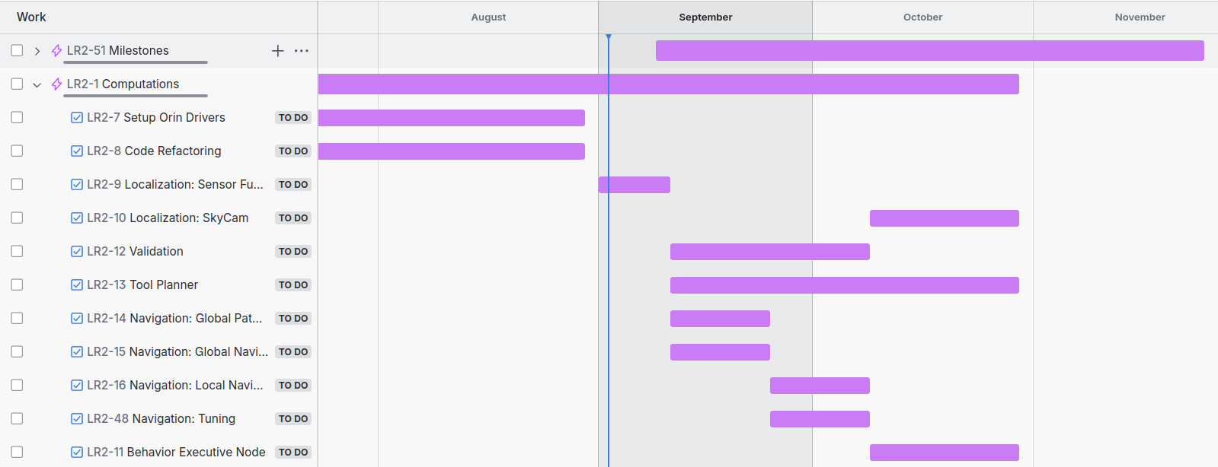
Schedule and Milestones
Notes:
Interactive and everyone needs to speak

Slide 20
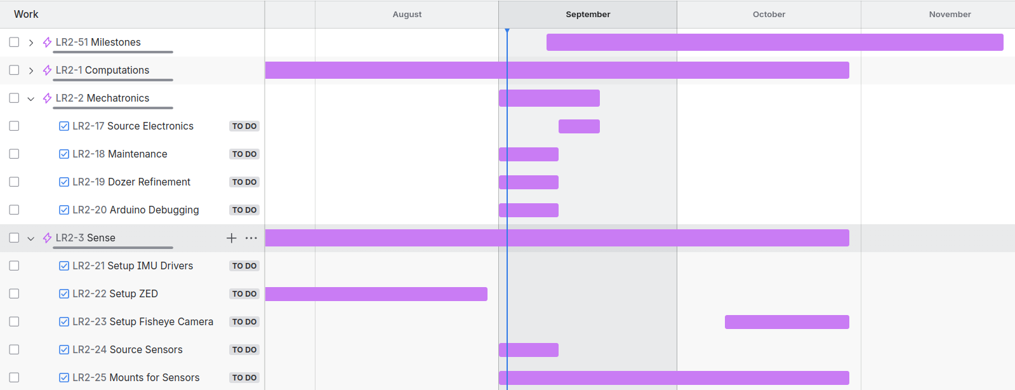
Schedule and Milestones
Notes:
Interactive and everyone needs to speak

Slide 21
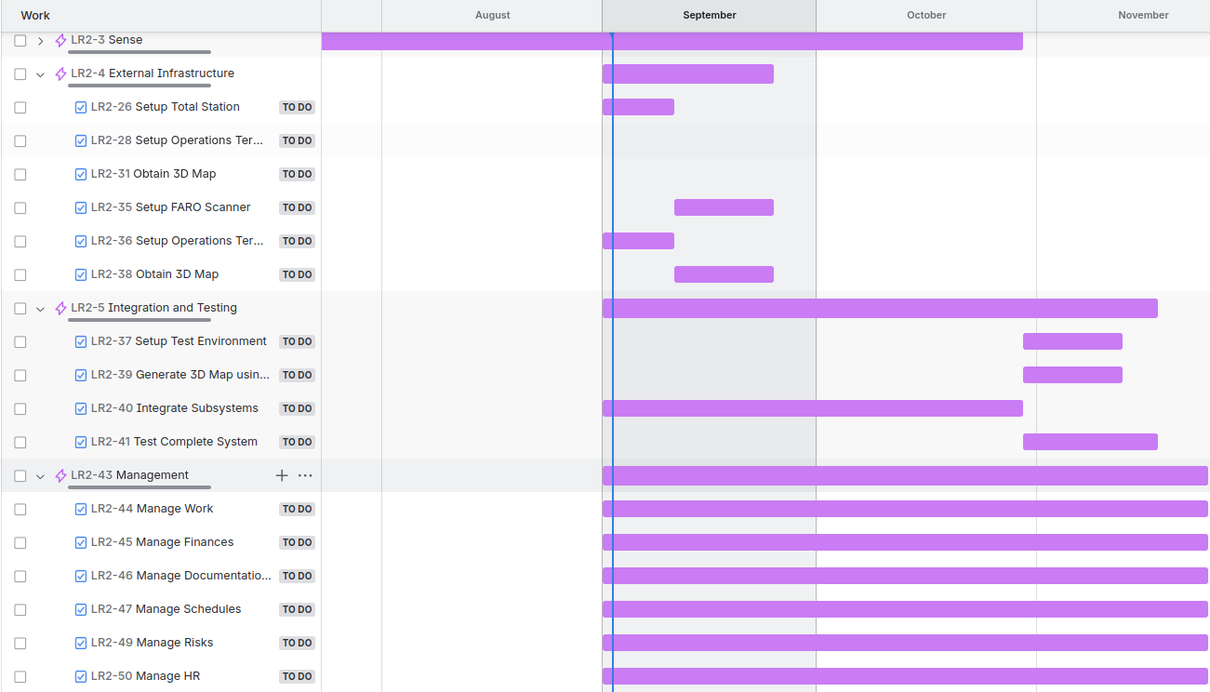
Schedule and Milestones
Notes:
Interactive and everyone needs to speak

Slide 22
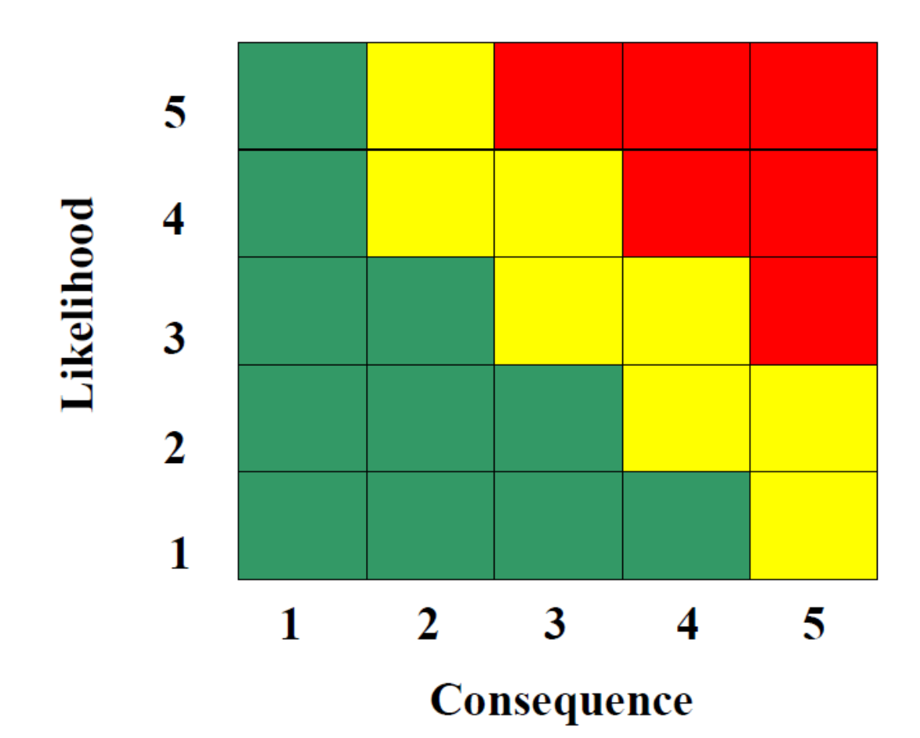
Risk Management (Updated)
Risk Summary
R10, R33, R34
R14
R2, R11
R19
R12, R24, R29
R30
R5, R7,
R20, R23,
R26, R27
R16, R28, R31, R35
R3, R6
R1, R32, R36
Notes:
This is our updated risk summary

Slide 23
Risk Management (Updated)
Reduced Risk Summary
R14
R10, R33
R2, R30
R5, R12, R19, R23, R27, R29, R31,R32 R34
R24, R28, R35
R3, R6, R11
R26
R7
R20
R1, R16, R36
Notes:
This is our updated reduced risk summary, allowing us to focus on the crucial ones

Slide 24
Top Risks
Risk ID | Risk Title | Risk Owner | Risk Type: | Logistics
R30 | No spares available | Team
Description |  | Date Added
Discontinued model, spare parts unavailable |  | 3/4/2025
 |  | Date Updated
 |  | 8/30/2025
Consequence
The whole project falling through, or redo almost all subsystems on a different rover.
Action/Milestone |  | Success Criteria | Date Planned | Date Implemented
Check out eBay and other similar platforms for spares |  | Successfully find exact spares on these platforms | 3/6/2025
Check out and stock similar parts if not same |  | Successfully find and stock similar parts | 3/6/2025
Find a twin rover that was used by a previous team on campus |  | Successfully find the twin rover and scavenge parts | 3/6/2025 | 3/7/2025
Maintain all parts, especially mechanical parts |  | Successfully avoid future breakdowns and part failures | 9/10/2025
Notes:
This is a recent and critical risk which is a consequence of an issue we faced last week. We noticed that one of the rear axles was broken and basically disengaged from the driveline.The spares are unavailable since the model is discontinued. Thanks to Red and Chuck, we found a twin rover for parts, but this remains a top concern as run a risk of the project falling through.

Slide 25
Top Risks
Risk ID | Risk Title | Risk Owner | Risk Type: | Technical
R33 | Localization frame shift after total station battery swap | Bhaswanth, William
Description |  | Date Added
Battery replacement in the total station causes small frame offsets, leading to localization inaccuracies. |  | 3/4/2025
 |  | Date Updated
 |  | 9/1/2025
Consequence
Leads to poor navigation performance and risk of missing the crater during grading operations.
Action/Milestone |  | Success Criteria | Date Planned | Date Implemented
Implement resection method using three known prism locations instead of orientate-to-line |  | Successfully fix the frame consistently after battery swaps | 9/1/2025
Explore and test alternative localization methods (using SkyCam) |  | Successfully maintain localization accuracy | 10/9/2025
Notes:
This is a recent and critical risk which is a consequence of an issue we faced last week. We noticed that one of the rear axles was broken and basically disengaged from the driveline.The spares are unavailable since the model is discontinued. Thanks to Red and Chuck, we found a twin rover for parts, but this remains a top concern as run a risk of the project falling through.

Slide 26
Top Risks
Risk ID | Risk Title | Risk Owner | Risk Type: | Technical
R34 | Arduino requires reset before operation | Bhaswanth
Description |  | Date Added
Arduino needs to be manually reset each time before starting autonomy or switching between autonomy and teleoperation modes. |  | 3/4/2025
 |  | Date Updated
 |  | 4/10/2025
Consequence
Slows down setup time and impacts operational readiness, delaying mission start and mode transitions.
Action/Milestone |  | Success Criteria | Date Planned | Date Implemented
Check USB port permissions and drivers issues on Jetson |  | Successfully establish consistent serial connection without reset | 4/26/2025
Verify that Arduino is connected via USB 3.0 instead of USB 2.0 port |  | Ensure stable high-speed communication | 4/26/2025
Check for ROS node frequency mismatches causing packet loss to Arduino |  | Match ROS publish/subscribe rates | 4/26/2025

Slide 27
Top Risks
Risk ID | Risk Title | Risk Owner | Risk Type: | Technical
R35 | Integration of ZED Camera with Lunar-ROADSTER stack | Deepam
Description |  | Date Added
Installing and setting up ZED SDK and ROS2 Wrappers in Docker might pose a problem due to insufficient support |  | 4/24/2025
 |  | Date Updated
 |  | 8/30/2025
Consequence
Delays in development and integration of Validation and Tool Planning sub-systems
Action/Milestone |  | Success Criteria | Date Planned | Date Implemented
Start installation and setting up early (during Summer) |  | Successfully install the ZED SDK and ROS2 wrapper in Docker | 4/26/2025 | 8/22/2025
Revert Back to Intel Realsense D435i |  | Successfully integrate Realsense D435i instead of ZED | 4/26/2025
Notes:
We've also recognized additional risks, such as finalizing electrical hardware, which depends on PDB design and could delay hardware completion.

Slide 28
Top Risks
Risk ID | Risk Title | Risk Owner | Risk Type: | Logistics
R36 | PRL Moonyard Access | William
Description |  | Date Added
Securing Moonyard access for testing/demos will be restricted and challenging |  | 8/29/2025
 |  | Date Updated
 |  | 8/29/2025
Consequence
No testbed available for testing and/or SVD
Action/Milestone |  | Success Criteria | Date Planned | Date Implemented
Devise and discuss a testing and demo plan with Prof. Red and Prof. David Wettergreen beforehand and reserve slots |  | Successfully meet and discuss the schedule of high priority projects | 9/9/2025
Complete Medical Evaluation to get unrestricted but controlled access |  | Successfully complete the Medical Evaluation and get unrestricted access to the Moonyard | 9/5/2025
Notes:
Restricted workshop access could slow down future manufacturing tasks.

Slide 29
Amalgamation of Traditional and Agile PM
Traditional PM:
Well-defined requirements and a clear project scope.
Structured schedule with milestones to meet deadlines.
Tasks are assigned based on a planned workflow, with periodic check-ins to track progress and ensure alignment with project goals.
Team members document their work thoroughly for transparency and tracking.
Test plans and risk management studies are conducted to identify and mitigate potential issues.
Budget and resources are carefully planned to ensure the project stays within budget.
Agile PM:
Early failure, quick adaptation, and rapid improvements.
Sponsor and stakeholder inputs drive subsystem refinements for the best MVP.
Individual ownership of tasks; linear organization
Daily stand-ups and Kanban boards for progress and scheduling.
Test-Driven Development ensures robust hardware and software reliability.
Team members collaborate across disciplines as needed.
Notes:
Interactive and everyone needs to speak

Slide 30
Amalgamation of Traditional and Agile PM
Why we chose amalgamation?
Structured Planning with Adaptive Execution.
Clear objectives and well-defined requirements, with quick adaptation to changes in subsystems without changing the scope
Risk Mitigation and Continuous Improvement
Predictive risk analysis and mitigation plans, with iterative approach for quick failure, fast learning and continuous enhancement
Efficient Team Workflow
Traditional task allocation and ownership, with cross-functional collaboration and decentralized decision making
Predictability and Adaptability
Predictive budgeting, scheduling and resource allocation, with allowing adjustments based on real-world testing and feedback
Notes:
Interactive and everyone needs to speak

Slide 31
Amalgamation of Traditional and Agile PM
Challenges of amalgamation
Daily stand-ups improve collaboration, but if not kept concise and focused, they can become repetitive and time-consuming, reducing productivity.
Agile allows frequent feedback, but balancing changes with a fixed timeline is challenging.
Traditional PM requires detailed documentation, while Agile prioritizes speed. Finding the right balance is crucial.
Notes:
Interactive and everyone needs to speak

Slide 32
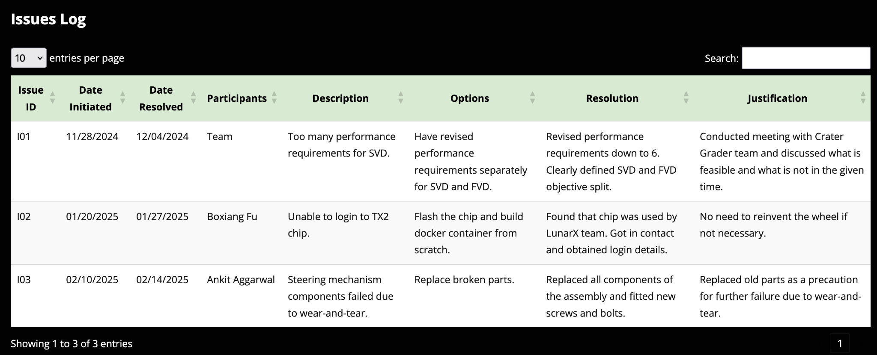
What Might Be Done Differently?
Better Schedule Tracking -
Identification of risks
Update issue log in timely manner
Notes:
Interactive and everyone needs to speak

Slide 33
Stand-Up Meetings
Daily Standups on Weekdays (5:30 - 5:45 PM)
Weekly Meetings with Sponsor - Dr. William ‘Red’ Whittaker (Friday)
Everyone is showing up :) (Sometimes members attend virtually)
Questions being used:
What have you worked on since the last Standup?
What are you going to work on?
Is there any help you need? Does your work affect anyone else’s ongoing work?
Some key highlights where standup solved problems
Resource Reallocation to meet a deadline - Project Course Assignments, Internal Milestones
Re-assignment of member’s tasks based on help needed
Bandwidth Management
Insights into technical work: Helping wherever a member is ‘stuck’
Awareness of all ongoing work - makes us feel like we are ‘working in a team’, not in silos
Notes:
Has anyone brought up and issue and how did you handle it?
(Each Team Member) What is the value of these meetings? If so what?

